Slide 1
Ministry of Science and Higher Education of the Russian Federation ITMO University School of Translational Information Technologies
Field of study «01.04.02 Applied Mathematics and Informatics»
Profile: Bioinformatics and Systems Biology 2023
Homework 3 of «Microbial Omics. ITMO. Fall 2024»
“Phylogenetics - mini course project”
Student of Group №: M4135, Institute of Applied Computer Science
Wong Pei Fong (Вон Пэй Фон)
Lecturer:
Mike Raiko
Saint-Petersburg, 31.10.2024

Slide 2
Purpose
To investigate distant phylogenetic events in animal evolution.

Slide 3
Workflow
Select mitochondrial markers: COX1 (mtco1), HSP60 (hspd1)
Choose organisms : Model organisms.
Download gene sequences from gene bank.
Merged all FASTA files of different organisms by marker.
Align the merged FASTA file.
Phylogenetic analysis.
Construct Neighbour Joining trees with bootstrap test (distance method).
Construct Maximum likelihood trees with bootstrap test.
Compare information with the trees, interpret the results.

Slide 4
Design
Study mitochondrial genes from 10 animal species, two invertebrates (Caenorhabditis elegans and Drosophila melanogaster) and 7 vertebrates (Danio rerio, Xenopus tropicalis, Gallus gallus, Homo sapiens, Mus musculus, Rattus norvegicus, Oryzias latipes),and the yeast Saccharomyces cerevisiae as an out-group.
The choice of species was determined by the availability of COX1 (mtco1) and HSP60 (hspd1) sequences in the NCBI Datasets.

Slide 5
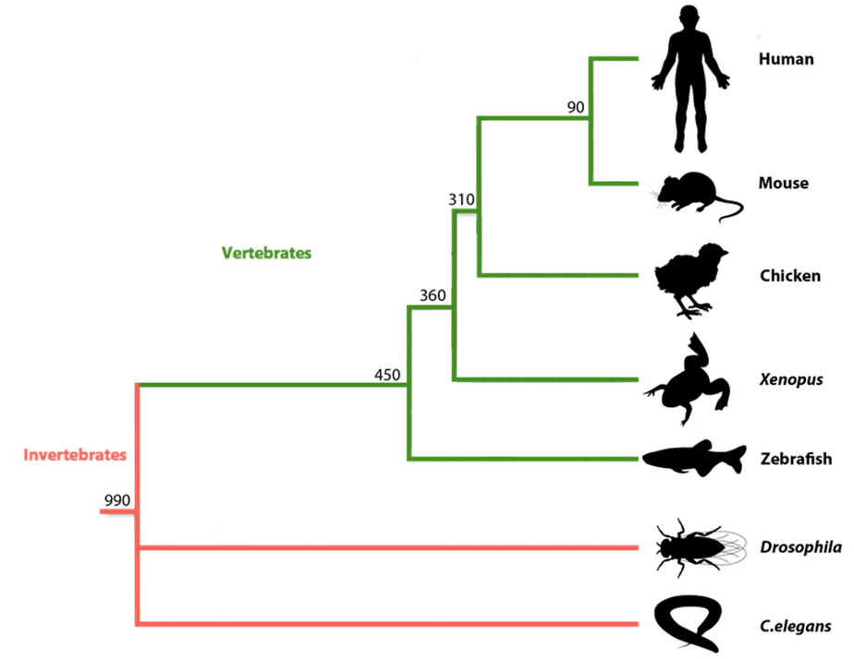
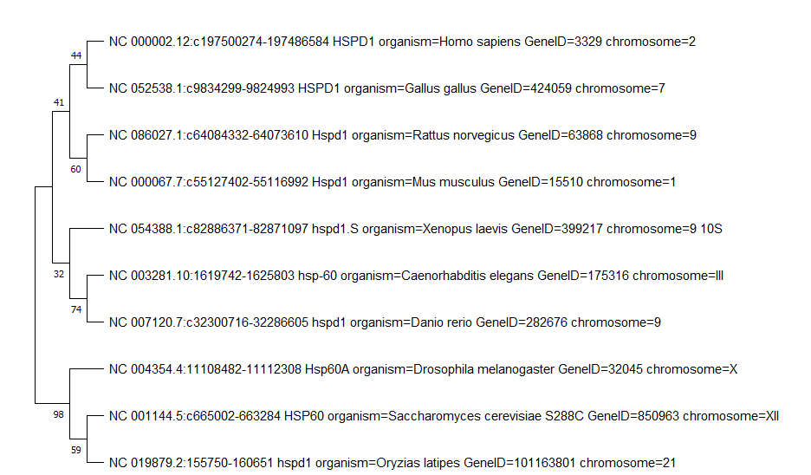
Neighbour Joining tree for HSP60 (hspd1)
2009 Jun;238(6):1287-308. doi: 10.1002/dvdy.21967.

Slide 6
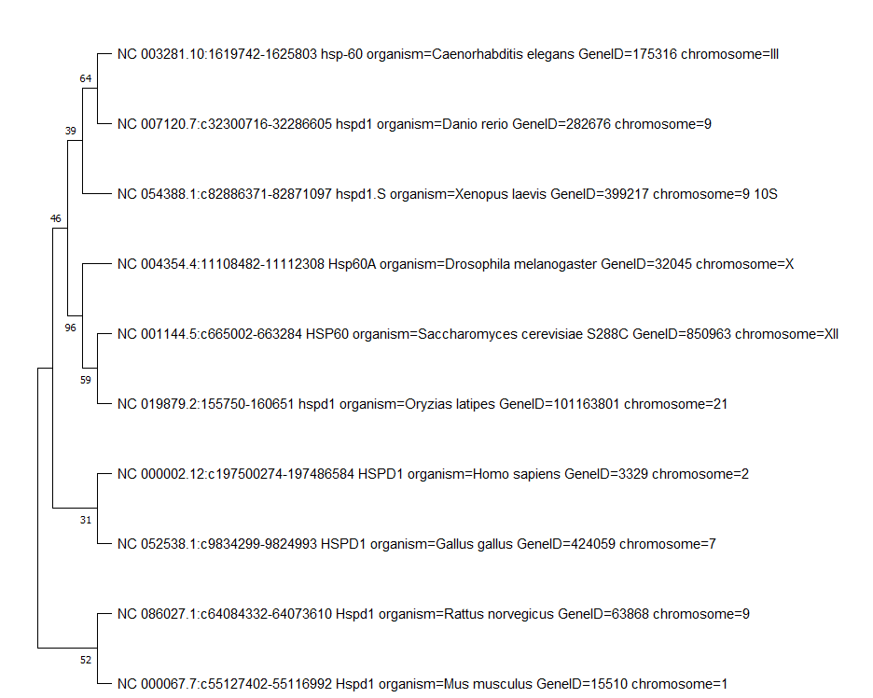
Maximum likelihood tree for HSP60 (hspd1)
2009 Jun;238(6):1287-308. doi: 10.1002/dvdy.21967.

Slide 7
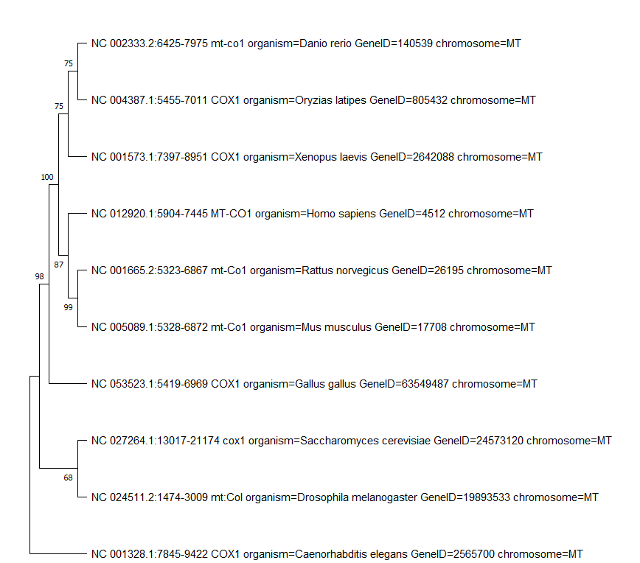
Neighbour Joining tree for COX1 (mtco1)
2009 Jun;238(6):1287-308. doi: 10.1002/dvdy.21967.

Slide 8
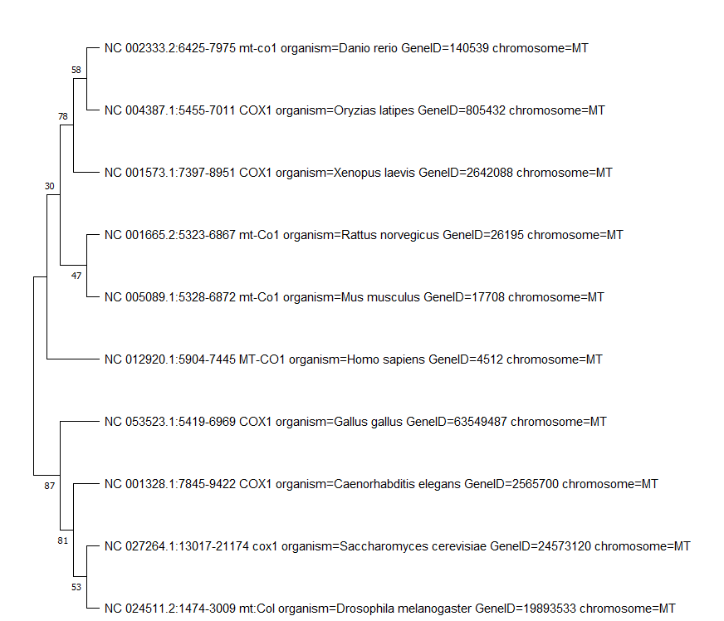
Maximum likelihood tree for COX1 (mtco1)
2009 Jun;238(6):1287-308. doi: 10.1002/dvdy.21967.

Slide 9
Conclusion
Trees constructed using HSP60 marker shows less phylogenetics correct corresponds to the reference.
Neighbour Joining tree for COX1 (mtco1) shows the most correctly relation corresponds to the reference.

Slide 10
Analysis settings for HSP60 (hspd1)
Neighbour Joining tree
Maximum likelihood tree
[General Info]
Data Type = nucleotide (non-coding)
No. of Taxa = 10
No. of Sites = 15275
Data File =
[Analysis Settings]
Scope = All Selected Taxa
Statistical Method = Neighbor-joining
Test of Phylogeny = Bootstrap method
No. of Bootstrap Replications = 500
Substitutions Type = Nucleotide
Model/Method = p=distance
Substitutions to Include = d: Transitions + Transversions
Rates among Sites = Uniform Rates
Pattern among Lineages = Same (Homogeneous)
Gaps/Missing Data Treatment = Pairwise deletion
Select Codon Positions = 1st,2nd,3rd,Non-Coding
Number of Threads = 8
[General Info]
Data Type = nucleotide (non-coding)
No. of Taxa = 10
No. of Sites = 15275
Data File =
[Analysis Settings]
Statistical Method = Maximum Likelihood
Test of Phylogeny = Bootstrap method
No. of Bootstrap Replications = 500
Substitutions Type = Nucleotide
Model/Method = Kimura 2=parameter model
Rates among Sites = Uniform Rates
Gaps/Missing Data Treatment = Use all sites
Select Codon Positions = 1st,2nd,3rd,Non-Coding
Initial Tree for ML = Make initial tree automatically (Default = NJ/BioNJ)
Branch Swap Filter = None
Number of Threads = 8

Slide 11
Analysis settings for COX1 (mtco1)
Neighbour Joining tree
Maximum likelihood tree
[General Info]
Data Type = nucleotide (non-coding)
No. of Taxa = 10
No. of Sites = 8158
Data File =
[Analysis Settings]
Scope = All Selected Taxa
Statistical Method = Neighbor-joining
Test of Phylogeny = Bootstrap method
No. of Bootstrap Replications = 500
Substitutions Type = Nucleotide
Model/Method = p=distance
Substitutions to Include = d: Transitions + Transversions
Rates among Sites = Uniform Rates
Pattern among Lineages = Same (Homogeneous)
Gaps/Missing Data Treatment = Pairwise deletion
Select Codon Positions = 1st,2nd,3rd,Non-Coding
Number of Threads = 8
[General Info]
Data Type = nucleotide (non-coding)
No. of Taxa = 10
No. of Sites = 8158
Data File =
[Analysis Settings]
Statistical Method = Maximum Likelihood
Test of Phylogeny = Bootstrap method
No. of Bootstrap Replications = 500
Substitutions Type = Nucleotide
Model/Method = Kimura 2=parameter model
Rates among Sites = Uniform Rates
Gaps/Missing Data Treatment = Use all sites
Select Codon Positions = 1st,2nd,3rd,Non-Coding
Initial Tree for ML = Make initial tree automatically (Default = NJ/BioNJ)
Branch Swap Filter = None
Number of Threads = 8

